Slide 1
MSc Artificial Intelligence
Knowledge Engineering
25 November 2024

Slide 2
Introduction to Probabilistic Reasoning
Logic and Knowledge Graphs are about statements of fact
Do we always have complete knowledge about the world?
Are our “facts” always precise?
Logic can handle incomplete knowledge
It cannot handle uncertain knowledge

Slide 3
Recap
You have previously studied some elementary forms of probabilistic reasoning
We are now going to build up the Bayesian Network, a probabilistic representation that is an attempt to model the causal relationships between a set of random variables
We will first need to remind ourselves of some basic concepts from probability theory

Slide 4
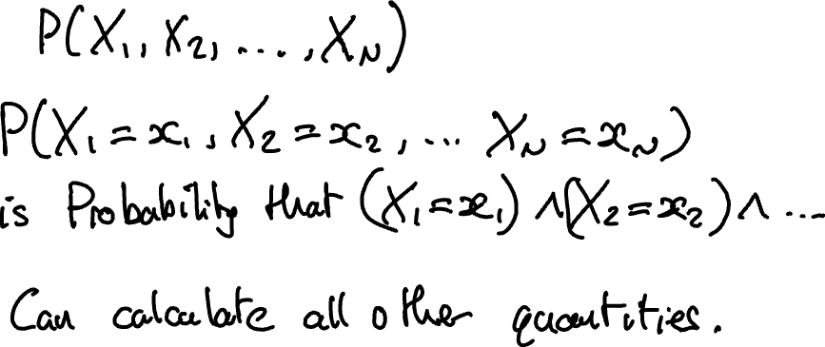
The Joint Distribution

Slide 5
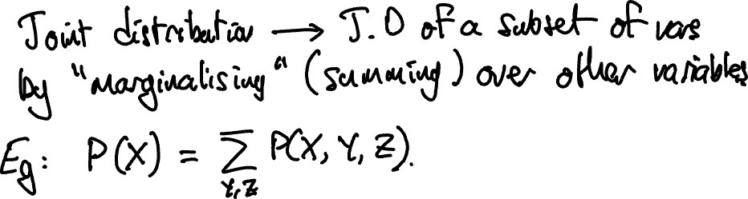
The Sum Rule

Slide 6
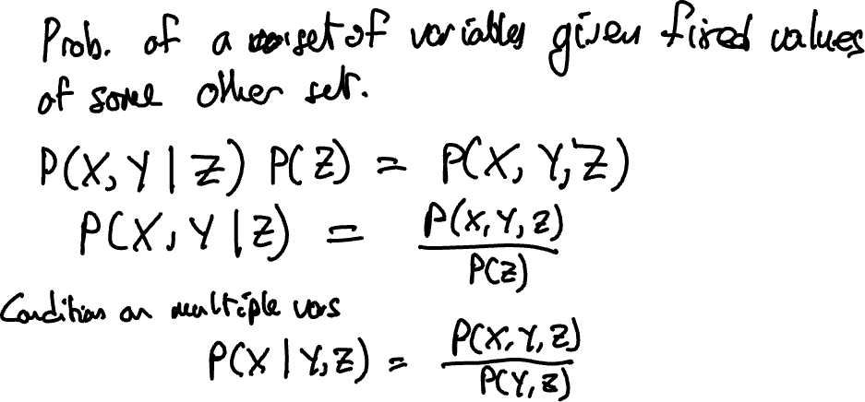
Conditional Probability

Slide 7
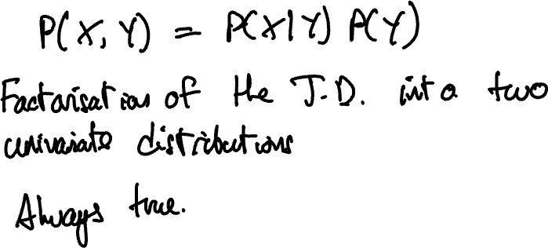
The Product Rule

Slide 8
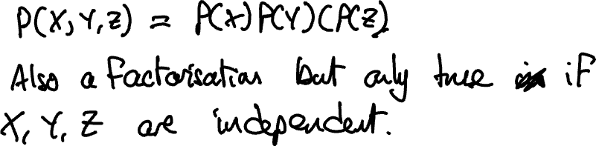
Independence

Slide 9
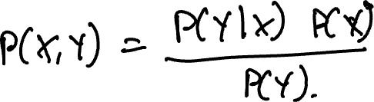
Bayes Rule

Slide 10
Exercise: Probably just about OK

Slide 11
MSc Artificial Intelligence
Knowledge Engineering
25 November 2024

Slide 12
Introduction to Probabilistic Reasoning
Logic and Knowledge Graphs are about statements of fact
Do we always have complete knowledge about the world?
Are our “facts” always precise?
Logic can handle incomplete knowledge
It cannot handle uncertain knowledge

Slide 13
Recap
You have previously studied some elementary forms of probabilistic reasoning
We are now going to build up the Bayesian Network, a probabilistic representation that is an attempt to model the causal relationships between a set of random variables
We will first need to remind ourselves of some basic concepts from probability theory

Slide 14
The Joint Distribution

Slide 15
The Sum Rule

Slide 16
Conditional Probability

Slide 17
The Product Rule

Slide 18
Independence

Slide 19
Bayes Rule

Slide 20
Exercise 13: Basic Probability

Slide 21

Conditional Independence
Independence is a powerful and useful assumption in many problems
But it does not apply in all situations
Joint distribution is hard to work with in large problems
Can we give the joint distribution some structure akin to independence but more general?

Slide 22
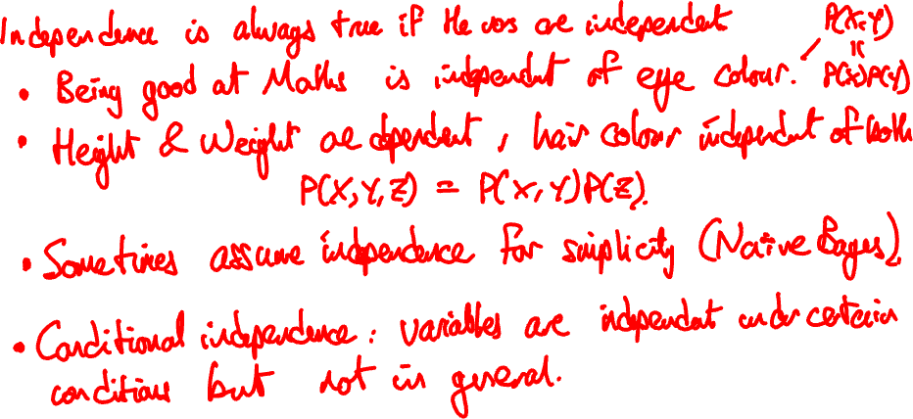
Conditional Independence

Slide 23
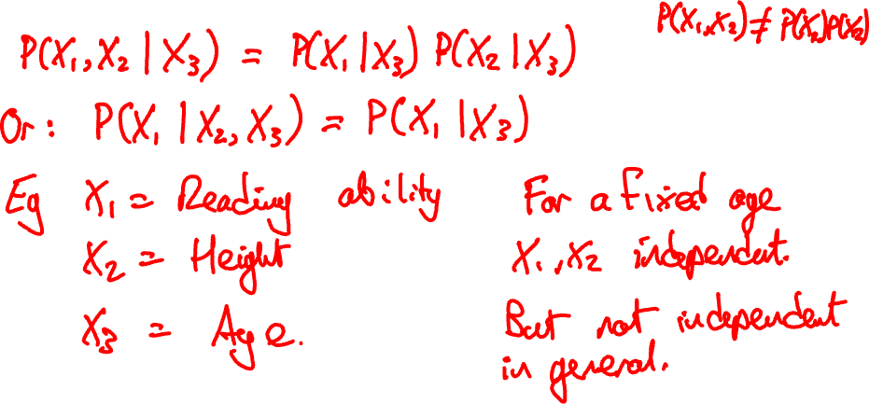
Conditional Independence

Slide 24
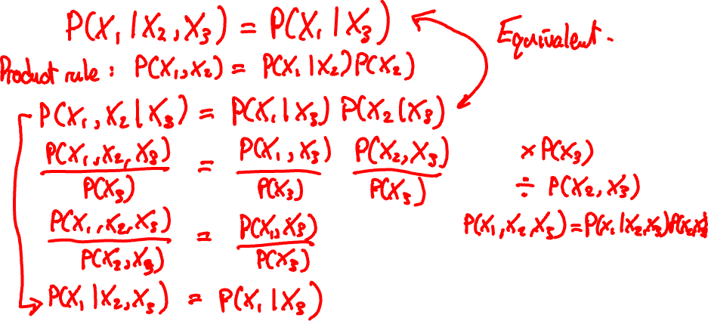
Conditional Independence

Slide 25
Exercises 14: Conditional Independence

Slide 26
A Computational Example
Let us now study conditional independence computationally via an example
Pedagogical exercise - not how you would do this in real-world problems

Slide 27
The Joint Distribution
Survey of school-leavers’ employment ten years after they finished high school.
The survey look at their careers:
which sector they worked in and what type of work they did)
and the subjects in which they graduated from high school.
We will consider a small part of this survey data and will look at the subset of people who
Studied Mathematics and/or Geography (or neither)
Pursued careers in Programming and/or Finance (or neither)
In other words, the full joint distribution has been marginalised over all variables except
M: studied Mathematics.
G: studied Geography.
F: works in finance.
P: works as a programmer.

Slide 28
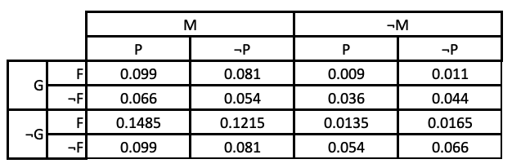
The Joint Distribution
Can you discern any obvious structure?

Slide 29
Any Patterns?
Not obvious what conclusions we can draw from this.
Is there any substructure in this from which we might infer something about the relationship between the variables?
We can calculate things from the joint distribution to see whether there are any patterns
Open Conditional Independence nocode.ipynb

Slide 30
Conditional Independence

Slide 31
What did we find?
Careers in finance and programming don’t depend on having studied Geographyt
They do depend on having studied Maths
But they don’t depend on each other.
How does this help us?
It allows us to factorise the joint distribution

Slide 32
The Product Rule Revisited

Slide 33
Exercise 15: Conditional Independence 2

Slide 34
MSc Artificial Intelligence
Knowledge Engineering
25 November 2024
Notes:
This colour bar is to be used for Artificial Intelligence

Slide 35
Bayesian Networks
Last lecture, established the idea of conditional independence
P(X,Y | Z) = P(X | Z) P(Y | Z)
We showed that the product rule could be used to factorise the joint distribution in terms of conditional probabilities, for example
P(G,M,F,P) = P(F | M) P(P | M) P(M) P(G)
Why is this useful and desirable?

Slide 36
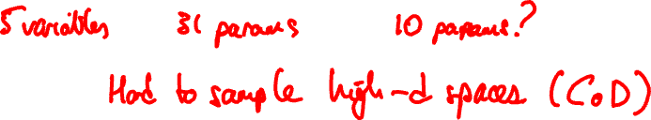
Benefits of Factorisation
Reduced number of parameters
P(G,M,F,P) = P(F | M) P(P | M) P(M) P(G)
15 parameters 6 parameters
Univariate conditional PDFs much easier to measure/estimate
Explicitly models causal structure
Models with the structure are called Bayesian Networks

Slide 37
Formal Definition
Graphical representation of factorised distribution
Directed graph
Each node corresponds to a single variable
Edges between node represents conditional relationships
Each node has associated condition probability distribution
Strictly acyclic – a directed acyclic graph (DAG)

Slide 38
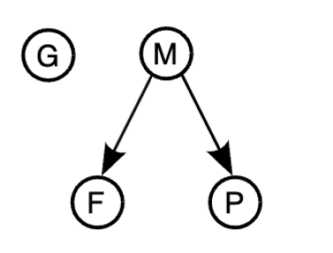
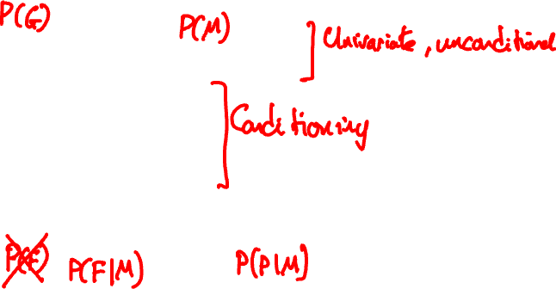
Example

Slide 39
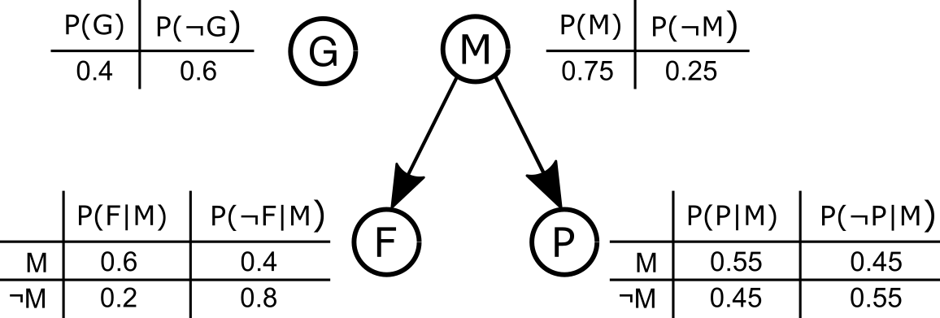
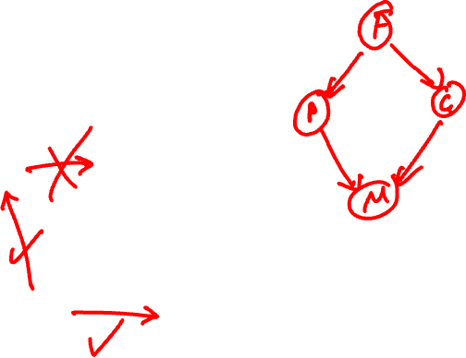
Example

Slide 40
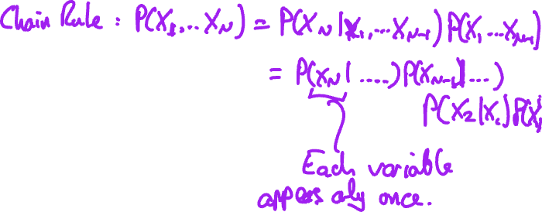
Constructing a DAG
Choose the variables needed to model the domain and order them. A good order has causes preceding effects and this will lead for a more compact representation.
For each node, choose a set of parents such that the chain rule is satisfied and that the parents can plausibly represent causes of the node's effect.
Add edges directed from parents to the node.
Write down a conditional probability table for the node.

Slide 41
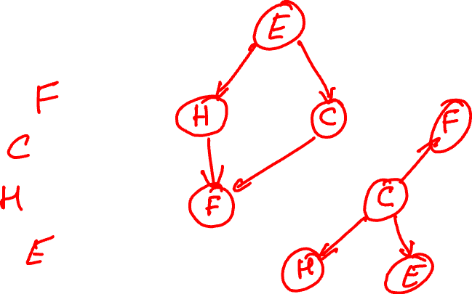
Example
Consider the following four events
Fire brigade called
Cat stuck in tree
House on fire
Explosion in kitchen
What might a DAG for these look like?

Slide 42
Exercise 16: Bayesian Networks

Slide 43
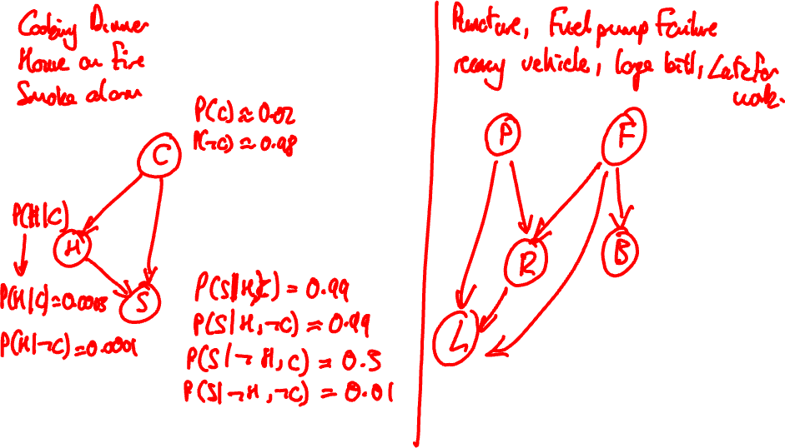

Slide 44
MSc Artificial Intelligence
Knowledge Engineering
28 November 2023
Notes:
This colour bar is to be used for Artificial Intelligence

Slide 45
Inference in Bayesian Networks
Once we have a Bayesian network, what can we do?
Network represents the joint distribution
So we can do anything that we can do with the joint distribution
Can compute the joint distribution and derive quantities from that
But that is wasteful and negates the advantages of the network
Can we compute directly?

Slide 46
Inference in Bayesian Networks
Open notebook
9. Exact Inference in Bayesian Networks nocode.ipynb

Slide 47
Exercise: Exactly

Slide 48
MSc Artificial Intelligence
Knowledge Engineering
25 November 2024
Notes:
This colour bar is to be used for Artificial Intelligence

Slide 49
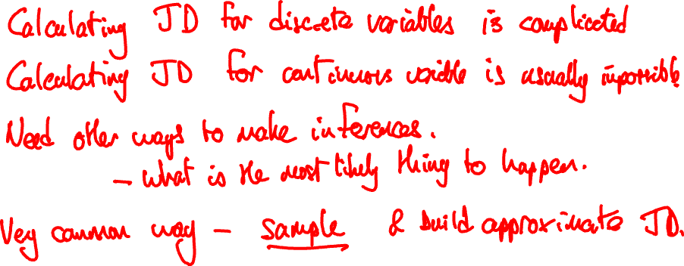
Approximate Inference

Slide 50
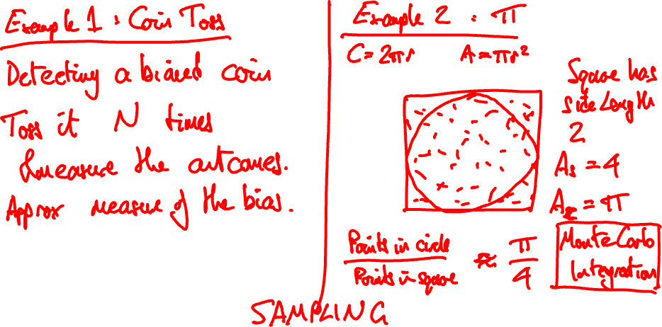
Approximate Inference

Slide 51
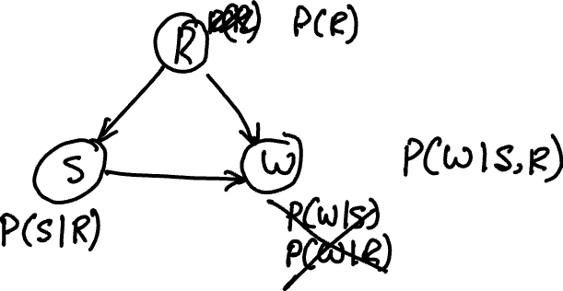
Approximate Inference

Slide 52
MSc Artificial Intelligence
Knowledge Engineering
25 November 2024
Notes:
This colour bar is to be used for Artificial Intelligence

Slide 53
Recap
Yesterday we showed how to perform exact computations on Bayesian Networks
And how to use random sampling approaches to perform approximate inference.
Both approaches have disadvantages
Exact inference is laborious and challenging
Discrete random sampling is slow, and also wasteful (Why?)
Today – two methods for improving approximate inference

Slide 54
Importance Sampling
Discrete sampling indiscriminately samples the whole sample space
Can support multiple queries
But for answer a specific question, very inefficient
Imagine we want to know P(M | P=True, G=False).
We can sample the whole space and use rejection sampling
Many samples go unused…
Can we just sample the subset that we want?
Yes (importance sampling)
Implement this
Can me made even more efficient – likelihood weighting.

Slide 55
Likelihood weighting
Imagine we have some evidence that means some variables should be fixed – evidence variables
The evidence must by definition be consistent with the posterior distribution
Sampling from the sample subspace that supports the evidence must take this into account
Not all evidence is equally well supported – we should account for the probability that a sample is more or less supportive of the evidence
This is the principle behind likelihood weighting

Slide 56
The Likelihood Weighting Algorithm
Fix all the evidence variables to their observed values
Sample non-evidence variables conditioned on the fixed evidence variables
Compute the probability that the sample you have just drawn would give rise to the evidence that you have fixed.
Include your sample in the trace, weighted by this probability.

Slide 57
Example
Imagine we want to know P(M | P=True, G=False).
Set weight w = 1.0.
G is an evidence variable and is fixed at False. Set w = w x P(G=False) = 0.4.
M is not evidence. Sample from P(M) = (0.25,0.75), suppose this returns True.
Sample from P(F | M=True) = (0.4,0.6), suppose this returns False.
P is an evidence variable and is True. Set w = w x P(P=True | M=True) = 0.4 x 0.55 = 0.22.
Record (False, True, False, True) with weight 0.22.

Slide 58
Why does this work?
All of the samples generate have the observed values of the evidence variables and so all of the samples can be used.
Improved accuracy (more samples) or faster convergence for a given level of accuracy.
Can be shown rigorously that weighting of the likelihoods in this way is fully consistent with direct sampling from the desired posterior distribution.

Slide 59
Markov Chain Monte Carlo
Discrete sampling and its variants all generate samples independently.
A new sample in the trace has no knowledge of any previous samples that have been generated.
A very common alternative treats the sampling as a *Markov Chain* in which the generation of the next sample depends on the current sample, but not on events prior to the current sample.
Markov Chain Monte Carlo (MCMC) sampling methods generate each successive sample by randomly modifying the current sample.
Gibbs Sampler is especially well suited for Bayesian Networks.

Slide 60
Gibbs Sampling
The Gibbs sampler is a Markov Chain
States are generated by making modifications to the current state
Begin by fixing all evidence variables to their observed values. These will not be changed through the sampling process.
Initialise all of the non-evidence variables to random values.
Initial values must be supported by the distribution attached to the variable but there are no other requirements.
A new state is created by sampling *one* of the non-evidence variables, chosen at random.
The sampling of the chosen variable will be from its conditional probability distribution which is implicitly or explicitly conditioned on its Markov Blanket

Slide 61
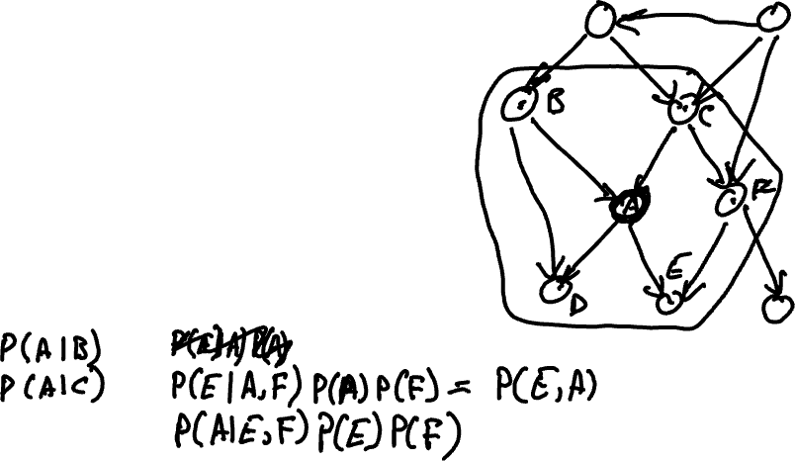
Markov Blanket
The set of variables that are either parents or children of the chosen variable, or are co-parents of the variable's children
Any variable is conditionally independent of all variables outside of its Markov blanket

Slide 62
Gibbs Sampling
The Gibbs sampler determines its outcome by counting how many times it visits each state and normalising.
If it visits a state where M is True forty-five times, and M is False fifteen times, the resulting distribution is P(M|F) = 45/60
The Gibbs sampler settle into an equilibrium in which it visits states according to a distribution that is equivalent to the posterior
Needs to reach that equilibrium – requires a burn-in period
Tricky to implement – we use a library: pymc3
Open 11. Approximate Inference nocode.ipynb

